Slide 1

SIDDHARTH INSTITUTE OF ENGINEERING & TECHNOLOGY
(AUTONOMOUS)
(Approved by AICTE, New Delhi & Affiliated to JNTUA, Ananthapuramu)
(Accredited by NBA for Civil, EEE, Mech., ECE & CSE
Accredited by NAAC with ‘A+’ Grade)
Puttur -517583,Tirupathi District, A.P. (India)
DEPARTMENT OF COMPUTER SCIENCE AND ENGINEERING
CSE (ARTIFICIAL INTELLIGENCE)
Academic Year 2025-26
Project First Review
Title of Project
Towards Green and Trustworthy 6G:Federated Learning Approaches for Robust Privacy
Batch Details
S.NO: | REG NO | NAME | INTERNAL GUIDE
1 | 22F61A3114 | C S MADESH | K EZHILARASI
2 | 22F61A3119 | D MOUNIKA
3 | 23F65A3101 | K ADIMURTHY
4 | 23F65A3106 | T VIJENDRA

Slide 2
OBJECTIVE
The objective of this project is to design and implement a privacy-preserving, decentralized machine learning system tailored specifically for the demanding environment of 6G networks.
With the help of Federated Learning (FL), the system enables multiple edge devices to collaboratively train machine learning models without sharing their raw data, thereby preserving user privacy and reducing network congestion.
The project involves developing a secure and interactive web application using Flask, where users can register, upload beamforming datasets, select from multiple machine learning algorithms, and receive real-time prediction results. The backend simulates FL rounds by averaging encrypted model weight updates from virtual edge clients.
Ultimately, the system demonstrates the feasibility and benefits of Federated Learning for future 6G-enabled intelligent infrastructure.

Slide 3
ABSTRACT
The next generation of wireless communication, 6G, is expected to interconnect billions of ultra‑intelligent devices and deliver sub‑millisecond latency for immersive applications such as holographic telepresence and autonomous mobility.
Traditional cloud‑centric AI pipelines cannot scale to this setting because continuous raw‑data transfer overloads backhaul links and exposes sensitive user information.To address this gap, our project implements a federated‑learning (FL) framework in which edge devices train models locally and share only encrypted weight updates with a coordinating server.
We prototype the concept in a Flask web application that allows users to register, upload sample beamforming datasets, choose among six candidate algorithms (Random Forest, FNN, CNN, MLP, XGBoost, Decision Tree), and receive real‑time prediction feedback on 6G beam‑forming success.

Slide 4
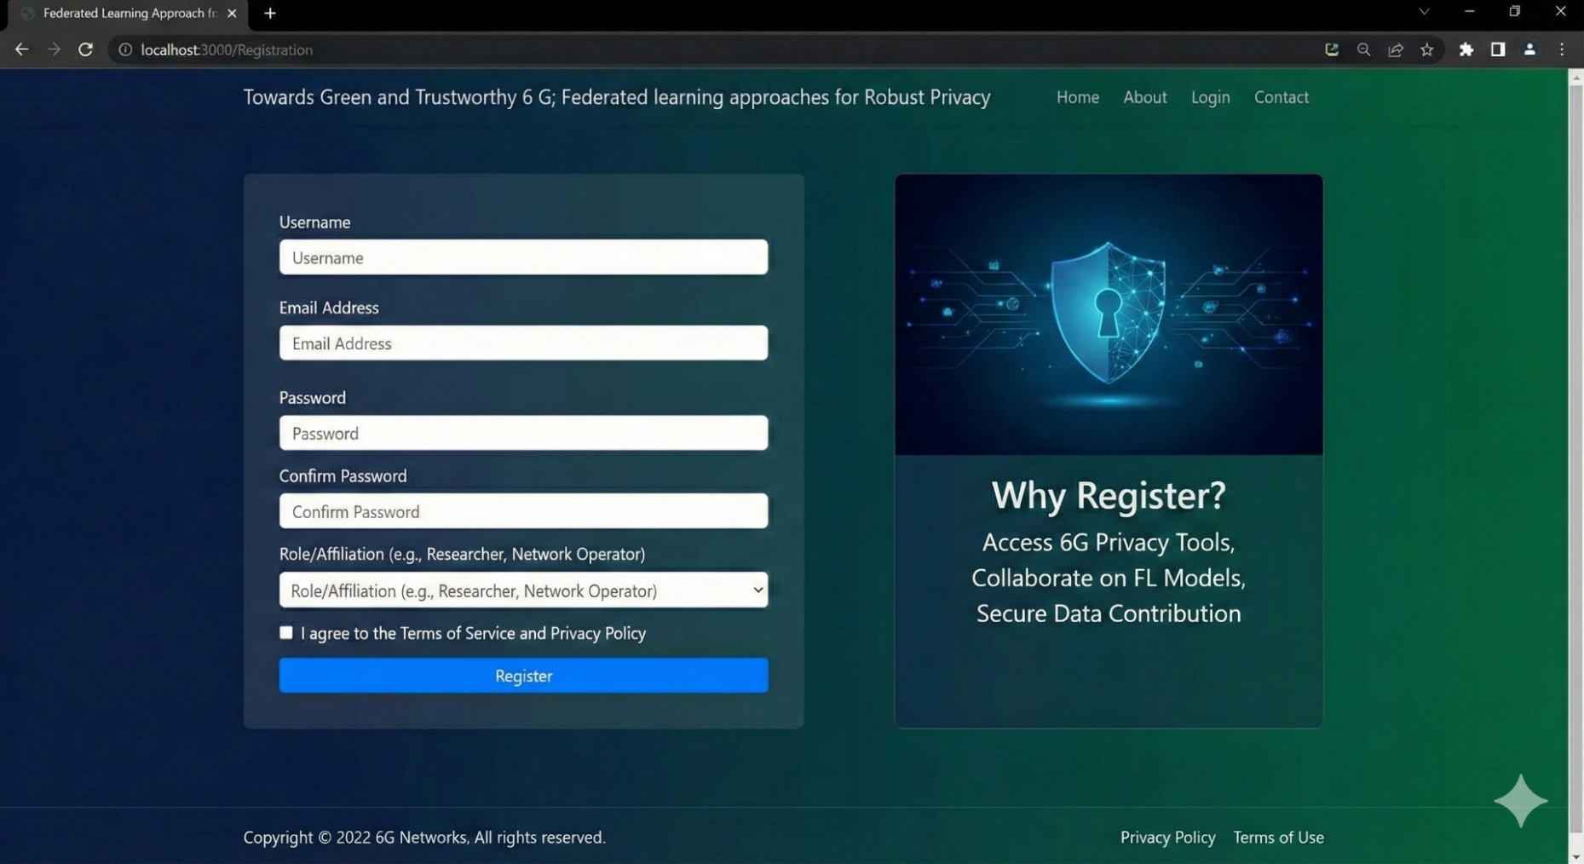
MODULES
REGISTRATION:
Users can create accounts by submitting their personal details.The system ensures that email addresses are unique, and passwords are confirmed to prevent errors.Once validated, user credentials are securely stored in the MySQL database,protecting user data.

Slide 5
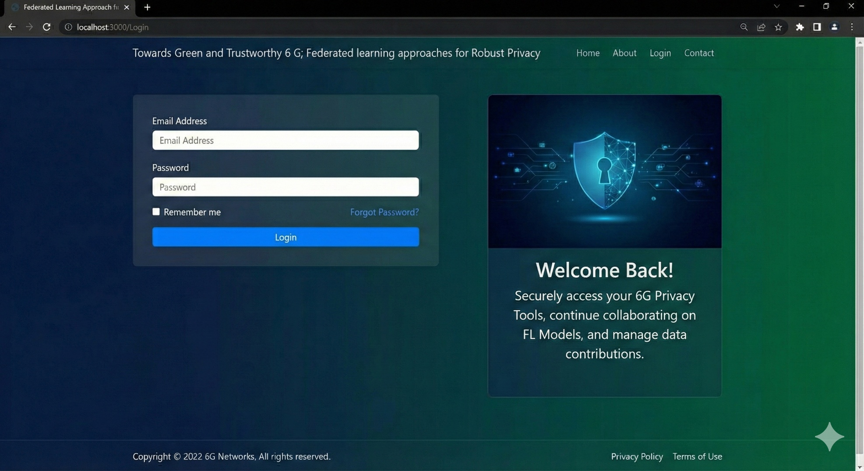
LOGIN AND SESSION HANDLING:
Users log in with their credentials, after which a session is created to allow access to protected routes like /home. This ensures that only authenticated users can access model predictions and other sensitive functionalities.

Slide 6
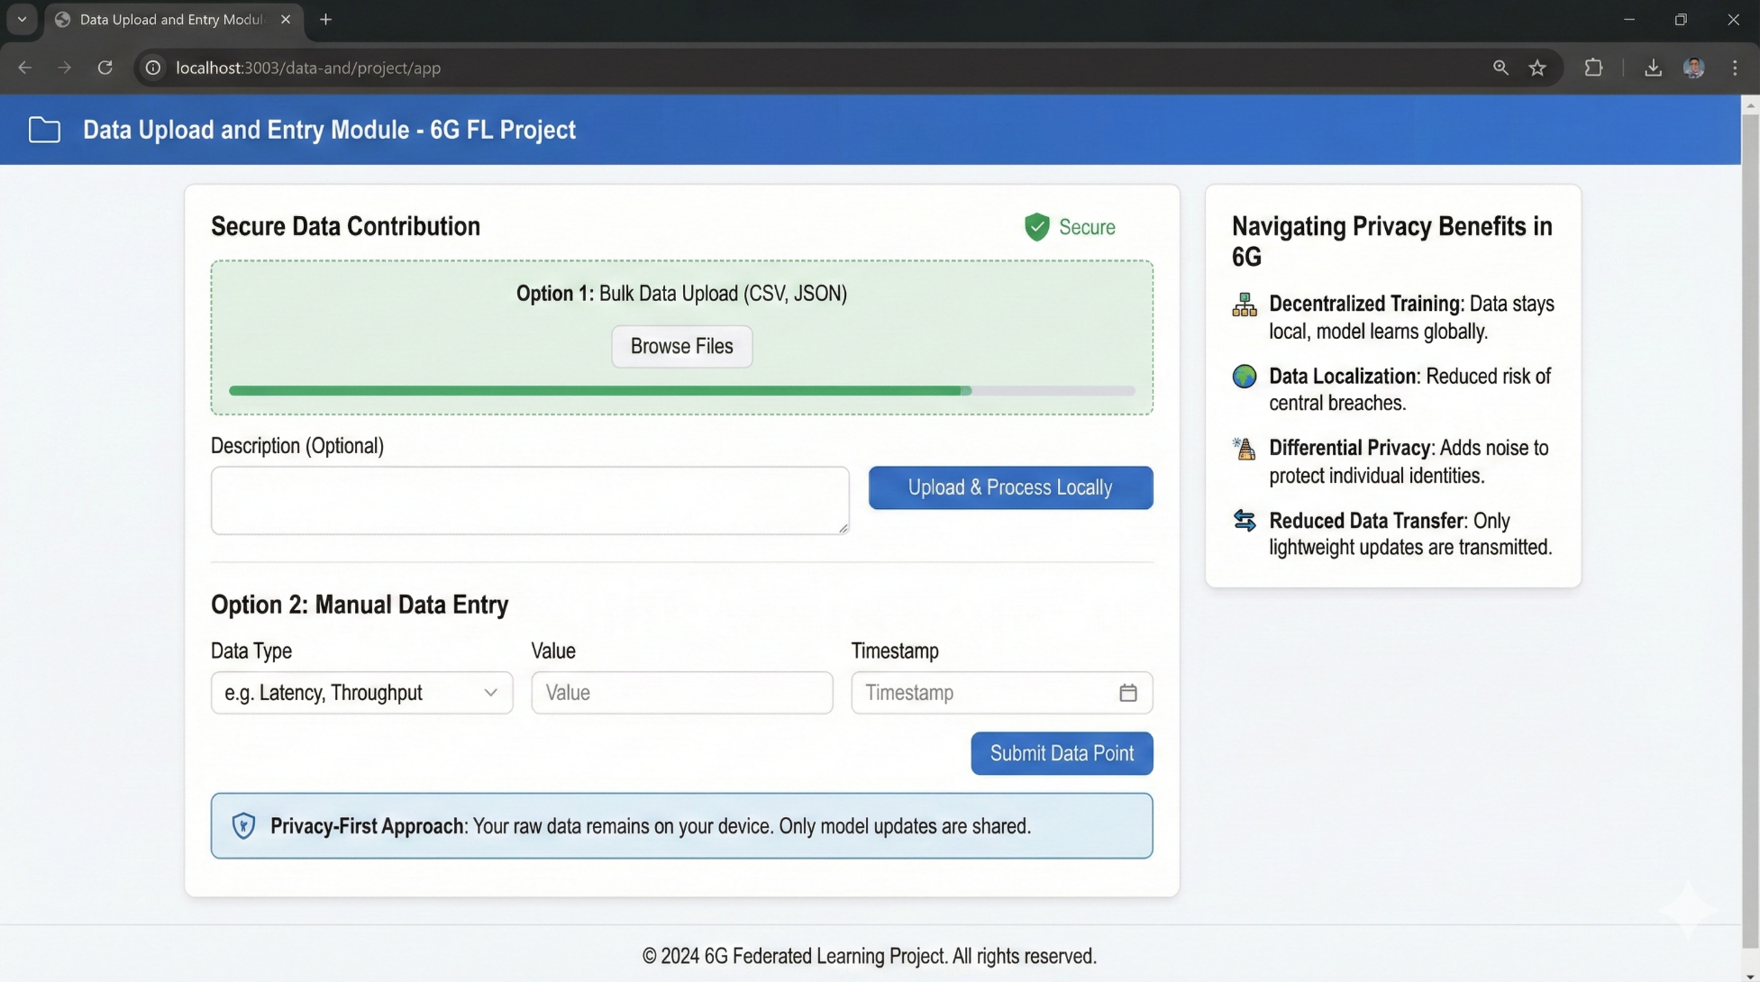
DATA UPLOAD AND ENTRY:
Users can upload their datasets via the /upload route or input data manually through forms. Once uploaded, the data is parsed and previewed for validation, making it easy to ensure data quality before it’s processed by the model.

Slide 7
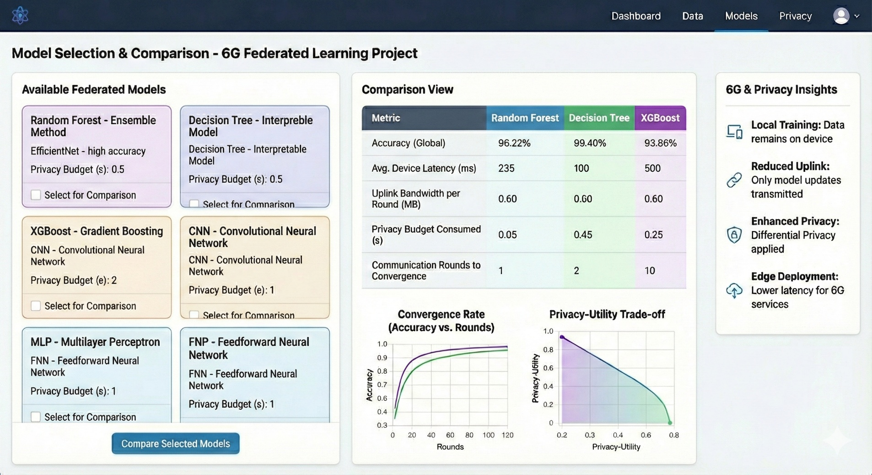
MODEL SELECTION AND COMPARISON:
Users can select their desired predictive model and view the corresponding accuracy metrics. This comparison allows users to make well-informed decisions when selecting the most suitable model for their task.

Slide 8
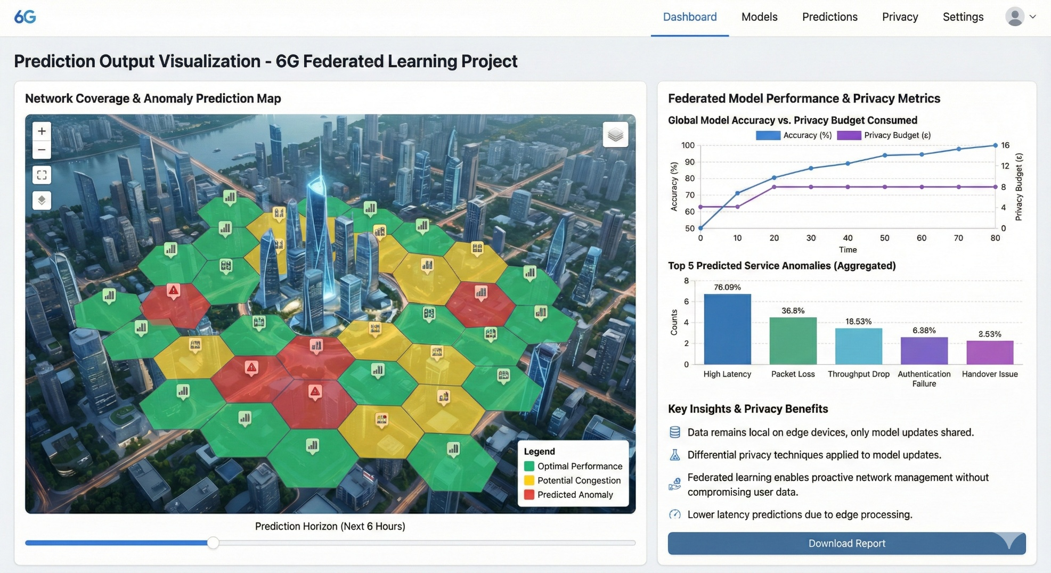
PREDICTION OUTPUT VISUALIZATION:
Once data is submitted, the system outputs a prediction in the form of either "Success (Beamforming will work)" or "Failure (Beamforming will fail)", displayed in an intuitive and well-organized HTML template for easy reading and interpretation.

Slide 9
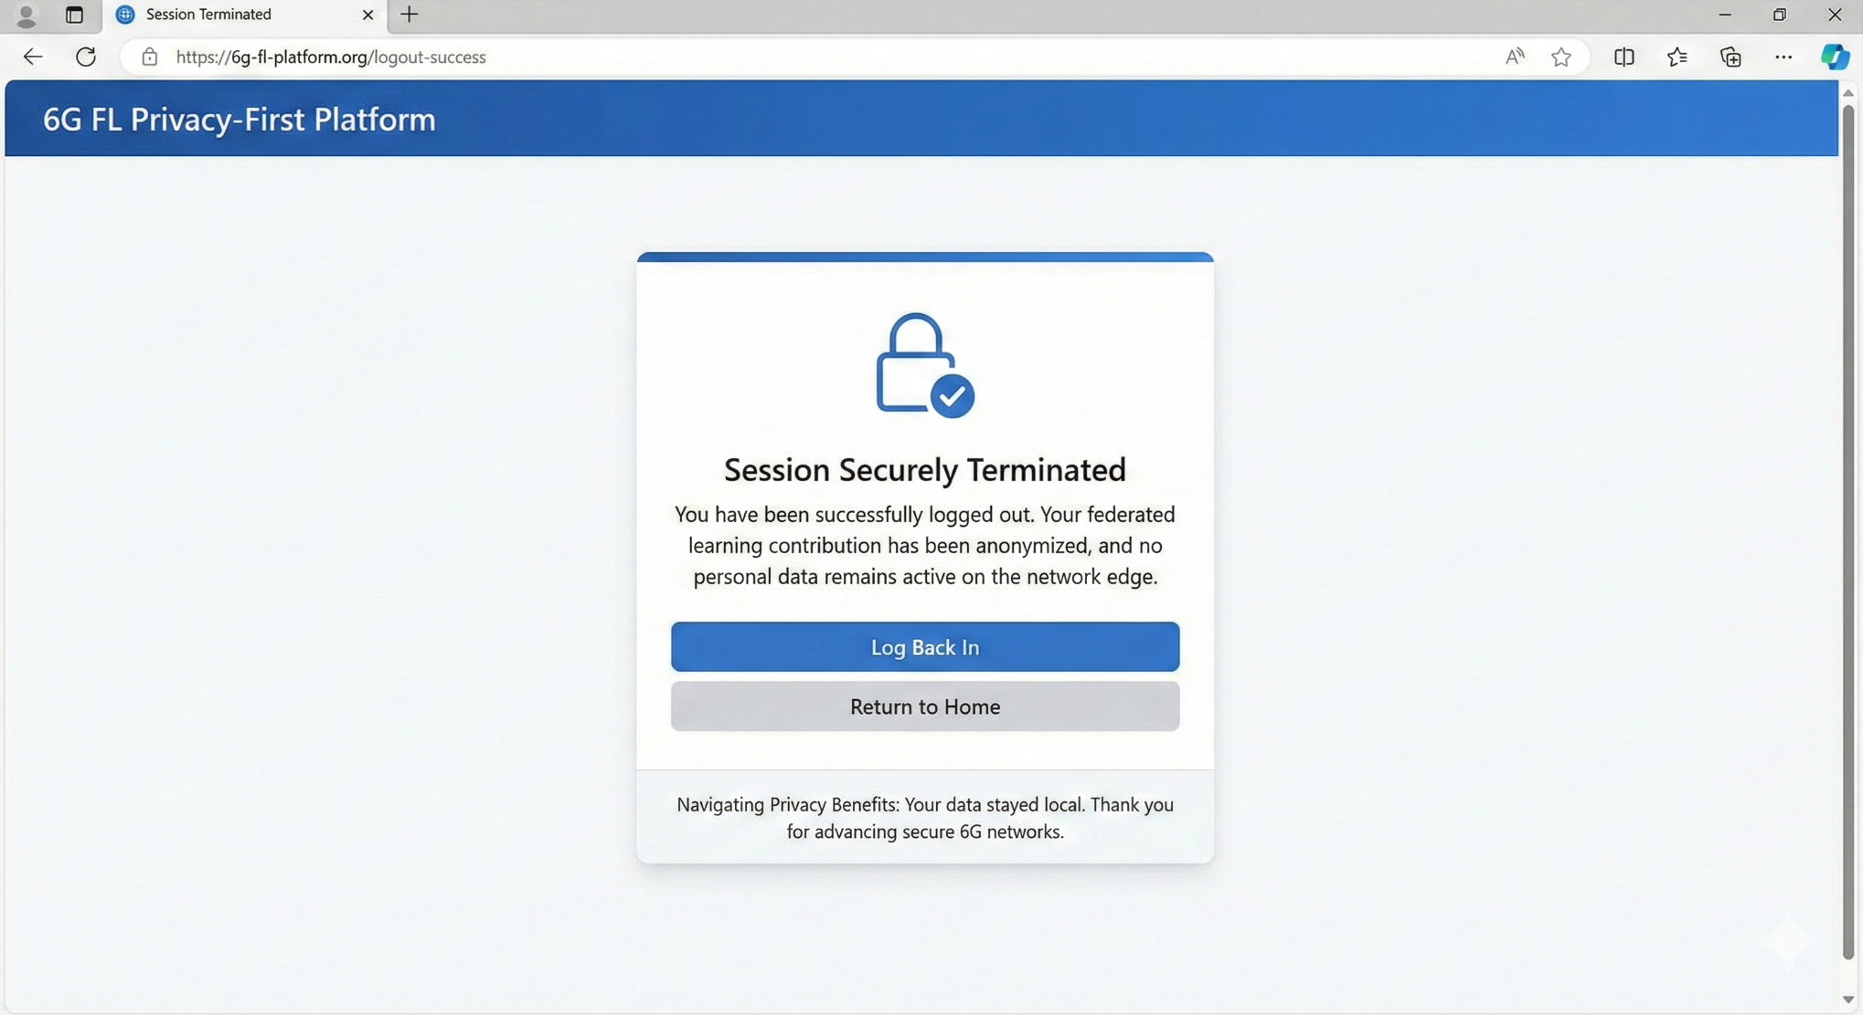
LOGOUT AND SESSION TERMINATION:
The logout functionality ensures that sessions are terminated securely, protecting user data and preventing unauthorized access to sensitive predictions or configurations.

Slide 10
TECHNOLOGICAL APPROACH
SERVER SIDE SCRIPTING TECHNOLOGIES
HTML, CSS, Bootstrap & JavaScript
- HTML: Builds web interface structure.
- CSS: Styles the UI for readability.
- Bootstrap: Provides responsive dashboards.
- JavaScript: Enables dynamic FL status updates and charts.
PYTHON PROGRAMMING LANGUAGE
- Core language for FL algorithms.
- Handles model training, aggregation, and data preprocessing.
-Used for implementing privacy techniques like DP and secure aggregation
BACKEND FRAMEWORK AND LIBRARIES
Flask Framework-Backend server for coordinating FL rounds.
Pandas Library- Cleans and structures training data on edge devices.
PyTorch (Torch)-Builds and trains local neural network models.
Keras Library-High-level API for fast model prototyping.
Scikit-Learn (Sklearn)-Provides ML algorithms and evaluation metrics.
NumPy-Performs numerical computations.
Seaborn-Visualizes FL performance.

Slide 11
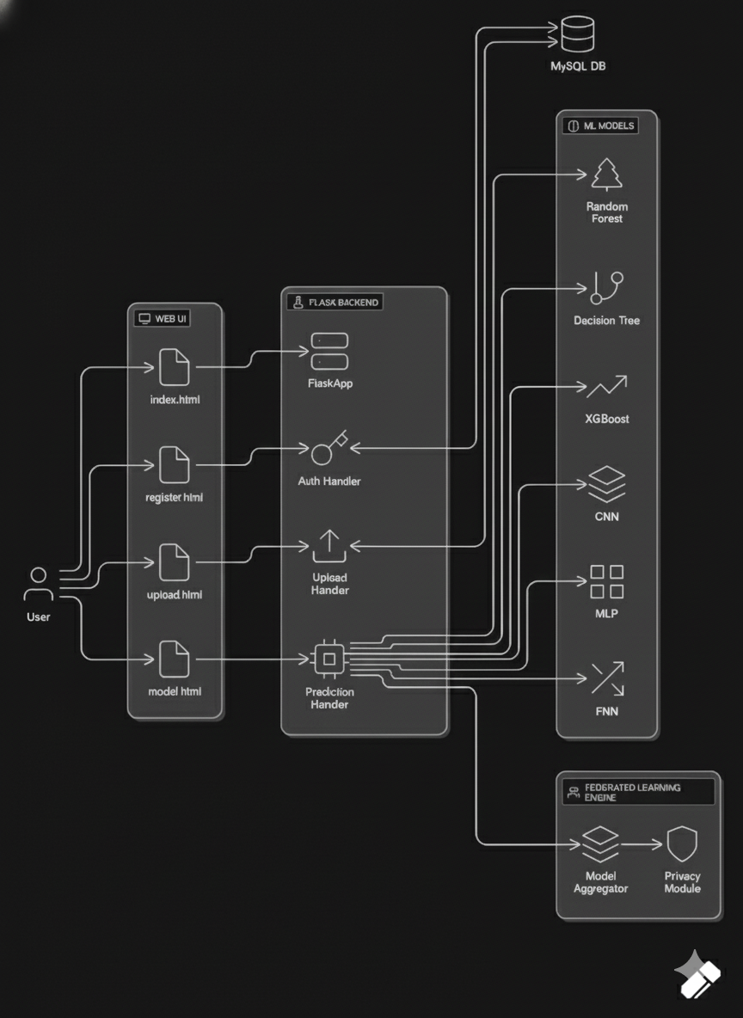
SYSTEM ARCHITECTURE

Slide 12
CONCLUSION
This study demonstrates the efficacy of a machine learning-based framework for early preterm birth prediction using Electrohysterogram (EHG) signals. By combining a custom device with the TPEHGDB dataset and extracting key features like Count Contraction and Entropy, we addressed the critical need for accurate maternal health monitoring. The application of SMOTE-ENN balanced the dataset, while models like Random Forest and Decision Tree achieved superior performance, validated by 10-Fold Cross-Validation. Metrics such as accuracy, precision, and F1-score underscored the robustness of these models. The findings highlight the potential of integrating biomedical signal processing with machine learning to support timely clinical interventions, offering a promising tool to reduce preterm birth complications and enhance neonatal outcomes globally.

Slide 13
THANK YOU

